Slide 1
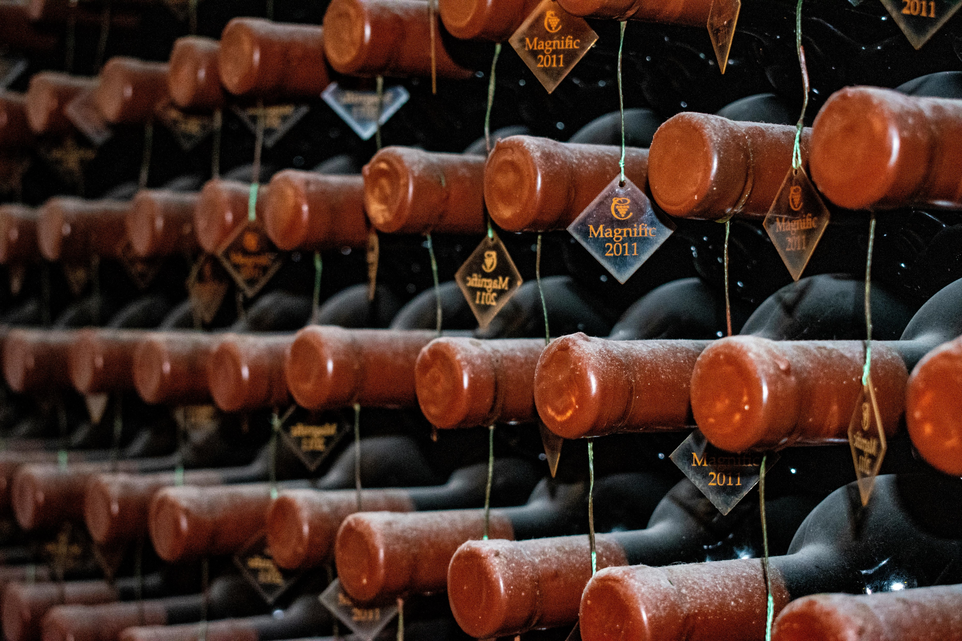
Wine and data
How can we predict wine quality?

Slide 2

Agenda
Introduction
Overview
Exploratory Data Analysis
Conclusion

Slide 3
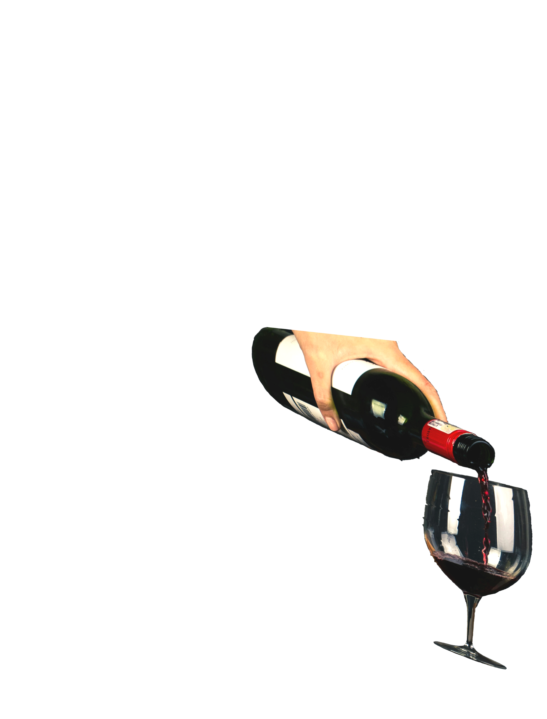
Introduction
The global market for red wine is worth over 87 billion USD and is growing.
Emerging economies, wine tourism, and health benefits are important factors.
Consumers want high-quality wine.
Understanding chemical properties is important for producers and in marketing.
We want to predict the quality of Portuguese Vinho Verde-style red wine based on chemical properties.

Slide 4
overview
The vast majority of Vinho Verde-style red wines are rated as medium quality.
Not all chemical properties are useful when trying to predict quality.

Slide 5
Exploratory Data Analysis: Regression analysis
We can use the equation above with measured chemical properties values to get a prediction quality score.
Only a handful of properties are used in this model.
The model correlates at 61% which is between moderate and strong.

Slide 6
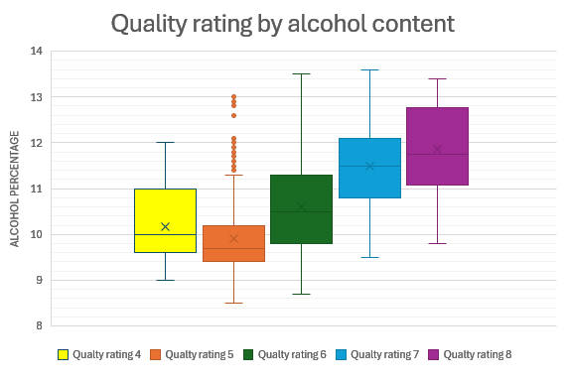
Exploratory Data Analysis: Alcohol and quality
Alcohol content has a moderate positive correlation with quality.
High-quality wines have a higher alcohol percentage in general. Typically over 11% alcohol.
Higher alcohol content as this perceived red wine as “richer”

Slide 7
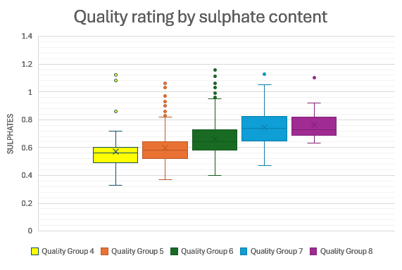
Exploratory Data Analysis: SULPHATES and quality
Sulphate content has a moderate to weak, but considerable correlation with quality.
Sulpate content increases steadily in each group
Values «tops off» at the high-quality groups 7 and 8.
High-quality wines usually have around 0.6 to 0.8 g / dm^3 sulphate content.
Sulphates contribute to the wine's “freshness”

Slide 8
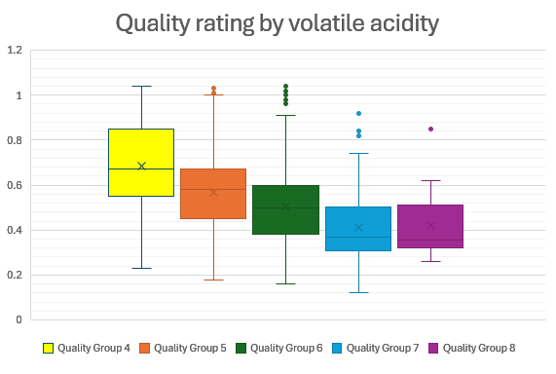
Exploratory Data Analysis: Volatile acidity and quality
Volatile acidity has a weak negative correlation with quality.
Mean values decrease as quality gets higher.
Ideal volatile acidity level for high quality is less than 50 grams per liter.
A low or moderate amount of acidity can increase the complexity of the wine.

Slide 9
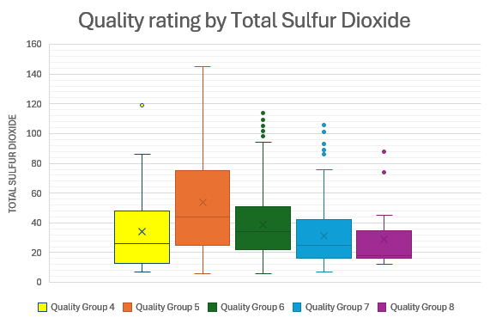
Exploratory Data Analysis: Total sulfur dioxide and quality
TSD has a weak but considerable negative correlation with quality.
High-quality red wine typically has less than 40 mg / dm^3 of TSD content.
TSD content can vary a lot, especially in medium-level quality wines.
total sulfur dioxide is about the balance between preservation and taste.

Slide 10
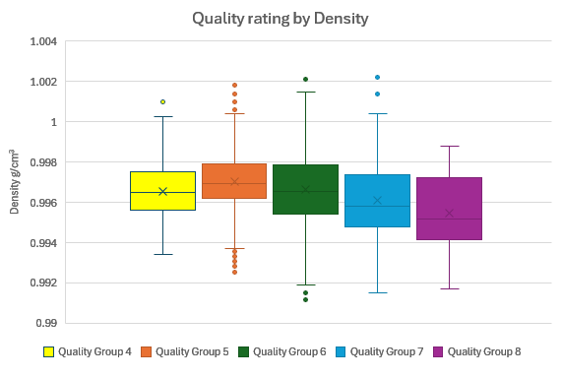
Exploratory Data Analysis: Density and quality
Density is weakly negative correlated with quality.
Differences in values are minimal.
Higher quality wine has a lower mean density value.
High-density wines often indicate higher sugar levels, which can lower balance and complexity.

Slide 11
Conclusion and applications
We can use the regression equation to help with quality predictions.
Higher alcohol and sulphate content is typically found in high-quality wine.
Higher values of volatile acidity, total sulfur dioxide, and density typically cause wine quality to drop.
Predictions can help red wine producers with quality control and ensure consistency.
High wine ratings can be used in marketing to signal good quality and determine pricing.

Slide 12
References

Slide 13
Explaining the presentation
Try to adhere to “10-20-30”-rule.
Simple and minimal design with red wine thematic coloring and images.
Only present the overall key findings, and not every detail.

